Slide 1
Logicsgame
By Tim Farahani, Max Maier & Marcel SOmmer

Slide 2

Agenda
Business Needs
Vision
Use Case(s)
SOFTWARE REQUIREMENT SPECIFICATION
SCOPE
BLOG
PROJECT MANAGEMENT
TECHNICAL ABILITIES
DEMO
CLASS DIAGRAM
Quality
Architecture
Configuration
Risk management
Testing
Patterns
Metrics

Slide 3
Business needs

Slide 4
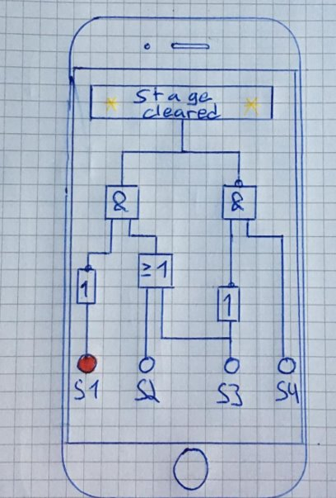
Vision
Smartphone game
Educational gaming
Easy to understand
Help players to understand logical gates
Deploy in schools
Lure pupils into technology

Slide 5
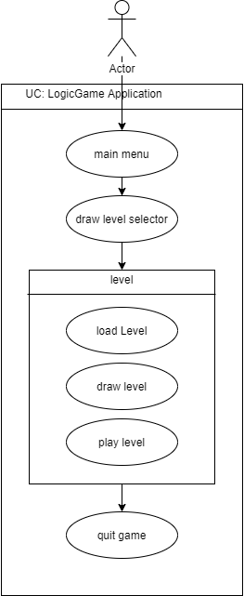
Overall Use case

Slide 6

USe cases
6 Use Cases:
Main menu
Draw level selector
Load level
Draw level
Play level
Quit game
Use case specification document for each one of them:
Description
Activity Diagram
Mock up
Function Point calculation

Slide 7
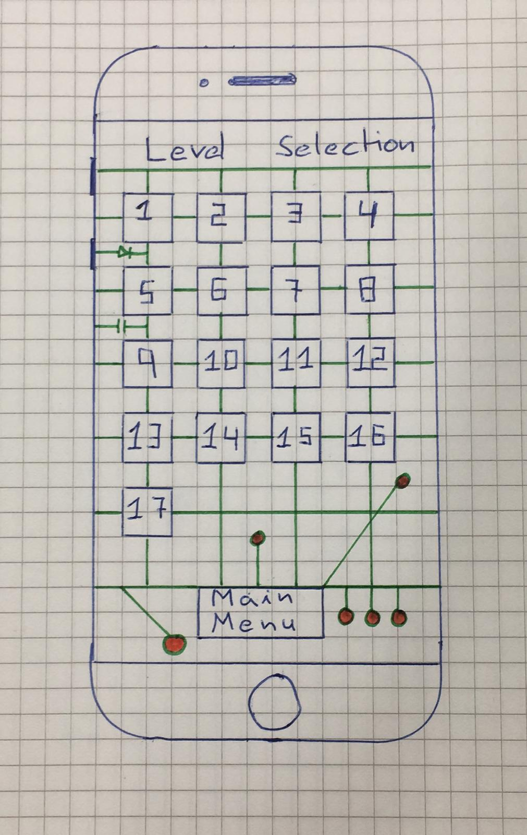
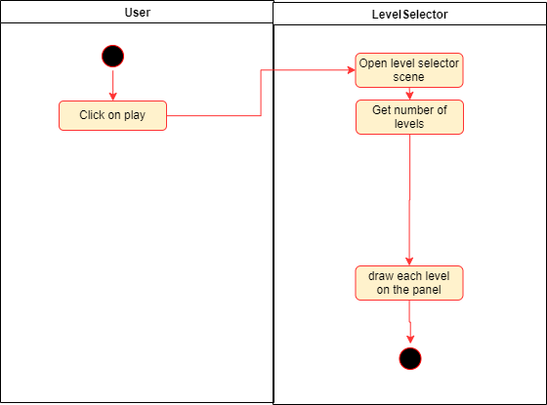
Use case example

Slide 8
SOFTWARE REQUIREMENT SPECIFICATION (SRS)
Document describes software requirements such as:
Functionality
Usability
Reliability
Performance
Supportability
Design Constraints
On-line User Documentation and Help System Requirements
Purchased Components
Interfaces
Licensing Requirements
Legal, Copyright, and Other Notices
Applicable Standards

Slide 9
Scope
KISS – keep it simple (and) stupid
game will be an android app only
only newer android phones will be supported
user interface where the user can choose the level that he wants to play
interface where the user can play the game
level is solved when the logic gates are correctly connected and the light bulb is lit
overall goal is to have a playable game, where more features and levels can be easily added later, after the project is done.
Out of scope: deploy game in Playstore and eventually in schools

Slide 10
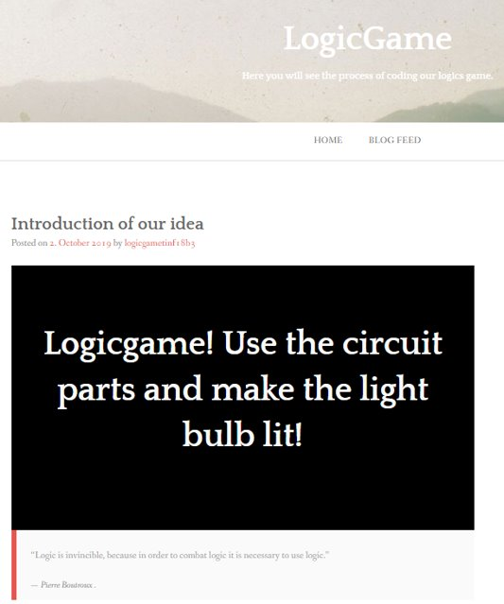
Blog

Slide 11
Project Management with youtrack
Free for students of DHBW
Issue list
Tracks Time spent
Integration with github
Different kind of reports
Coordinate tasks
Allows sharing content
Easy to use
Recommended

Slide 12
Project Methodology: Scrum
Agile project management
Iterative process
Way more flexible than waterfall
Adjustable to costumer’s specification changes
Weekly Sprints --> check and communicate with team members
Agile board as an overview
Showing partial result to inform costumer about the progress

Slide 13
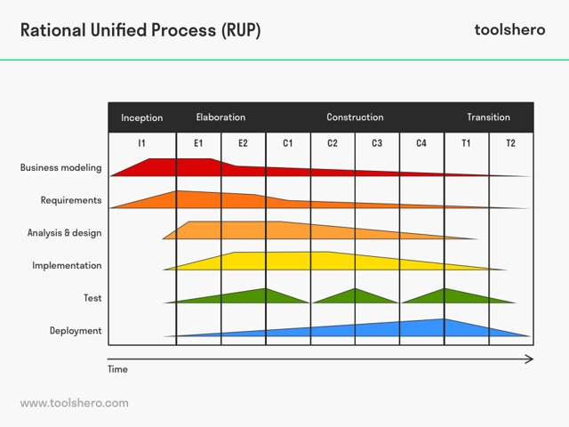
RUP

Slide 14
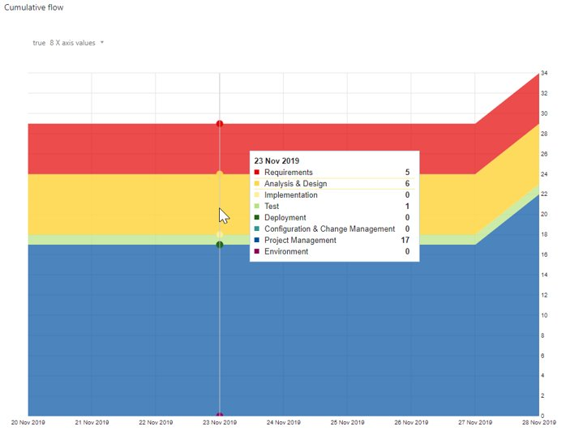
Cumulative flow project begin

Slide 15
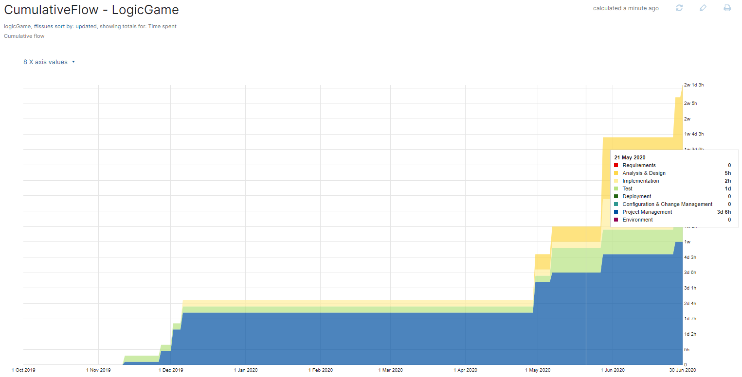
Comulative flow project progress

Slide 16
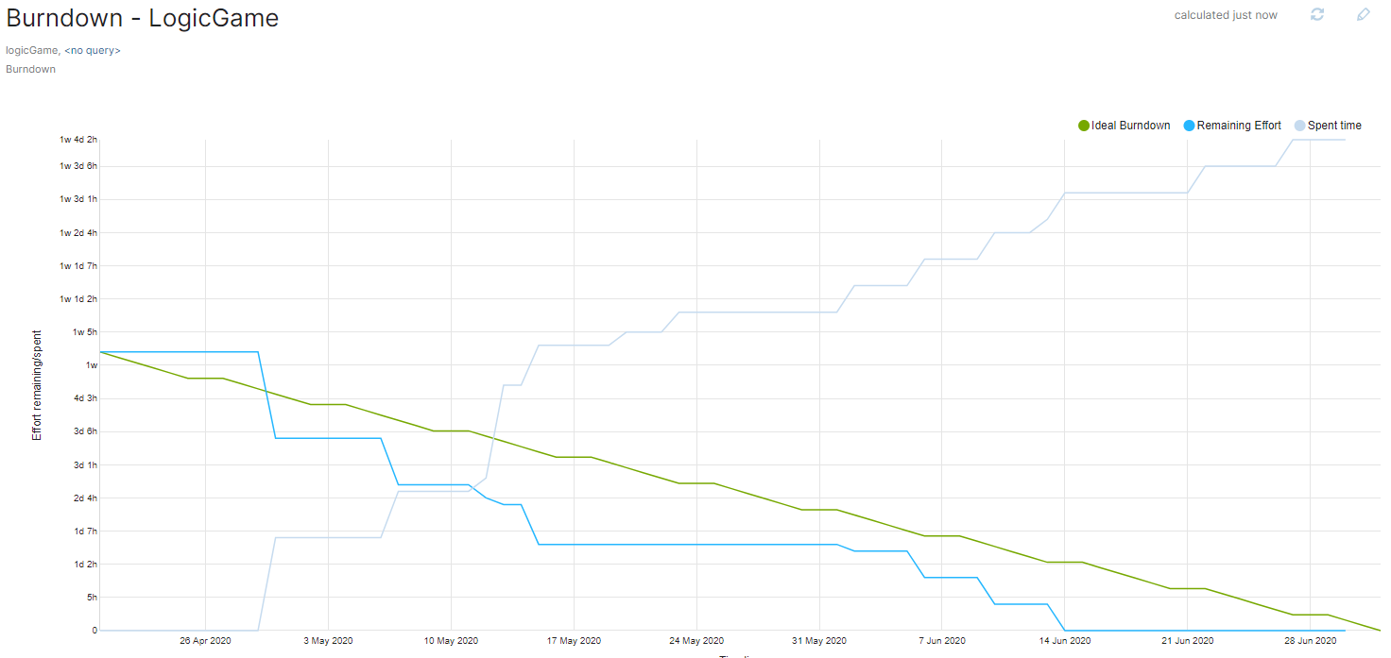
Burndown

Slide 17
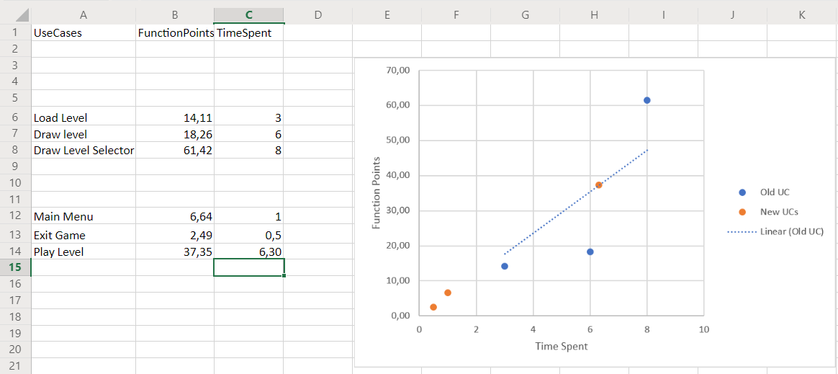
Cost Estimation (Time is money)

Slide 18
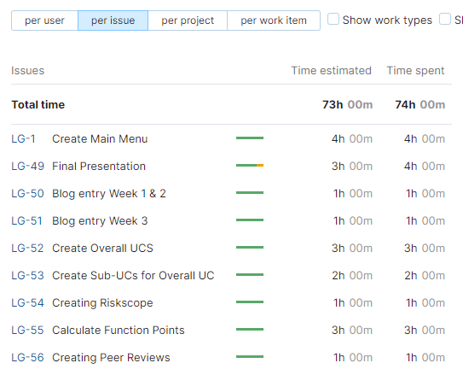
Time Report

Slide 19
Technical Abilities

Slide 20
Demo

Slide 21
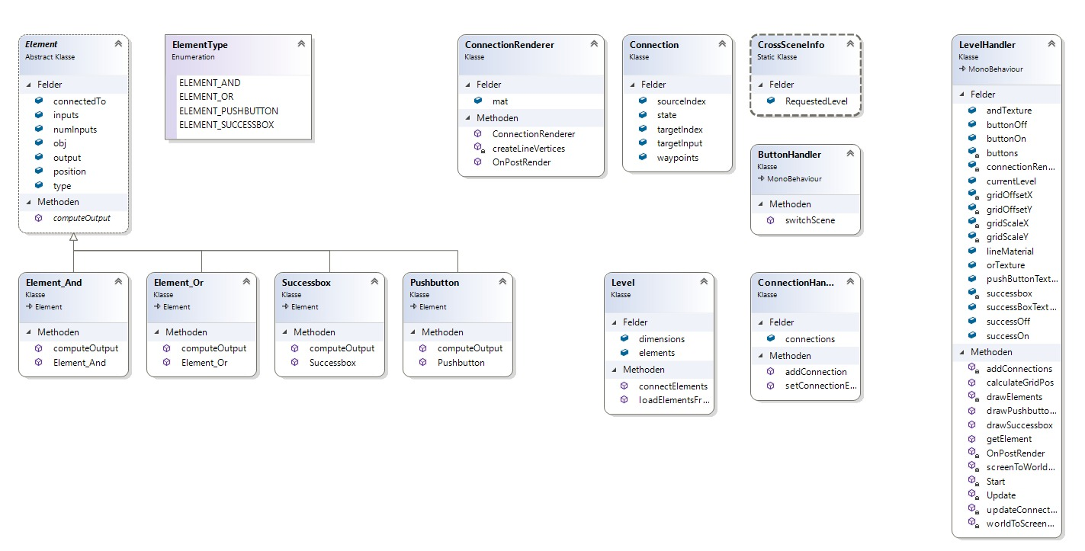
Class diagram

Slide 22
Quality

Slide 23
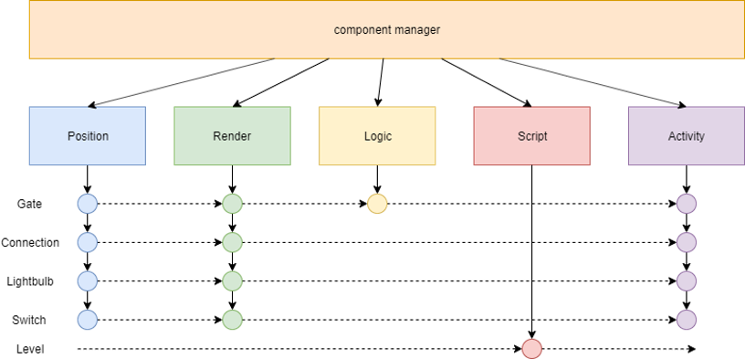
Component Architecture

Slide 24
Software Architecture Document (SAD)
Document describes Software Architecture such as:
Architectural Representation
Architectural Goals and Constraints
Logical View
Design Patterns
Metrics

Slide 25
Configuration

Slide 26
Unity
Game-Engine & Framework
Component-based programming
Easy & free to use
Huge community
Cross-Platform

Slide 27
Visual Studio Community 2019
IDE
Free for students
Syntax highlighting
Autocomplete
Plugins for Unity
Goes hand in hand with unity
C# compiler
Visual Studio Liveshare

Slide 28
Github
Development platform
Host and share code
Review options
Automatically distributed versions
Documentation
Accessible from everywhere & everyone

Slide 29
Tortoise git
Integration of github in a perfect and simple windows tool
Pull, push, diff, commit very quick and simple
UI for windows
Version control

Slide 30
Automation & Lifecycle management
A Push into github triggers Codacy and Codeclimate --> Metrics are updated
Automatic version control due to github commits
Documentation updates files automatically due to relative links to git repository
New levels can be created and added easily
Future: automatic deployment of new releases due to Playstore integration

Slide 31

RISK Management
excel sheet that shows a list of risks
kept up to date on a weekly basis
Example:

Slide 32
Testing
Document describes test plan:
Introduction
Evaluation Mission and Test Motivation
Outline of Planned Tests
Test Approach
Entry and Exit Criteria
Deliverables
Testing Workflow
Environmental Needs
Responsibilities, Staffing, and Training Needs
Iteration Milestones
Metrics

Slide 33
Patterns
Singleton: software design pattern that restricts the instantiation of a class to one “single” instance
useful when exactly one object is needed to coordinate actions across the system
Created a branch on github --> not in our actual code --> unity project
Doesn't make sense to use in class “elements” --> can't have multiple elements with different properties united in one instance
Makes sense to use in "cross scene info" class --> exchange variables between the scenes --> makes sense to only have one instance of it

Slide 34
Metrics: Codacy and Codeclimate
Extra branch in github --> not implemented in our actual code
Parts of the metrics don't make sense to implement
Example:
Codacy suggested to remove our start() method, because it thought it was unused. The Method is never called manually, Unity calls it automatically.
Codacy suggested to make a public variable private and use getters and setters for it. Those variables are set in the unity editor and therefor cannot be accessed with getter and setter methods.

Slide 35
Future Possibilities
More levels --> automatic level generator
Making money through advertisement
Pay for pro version to get it ad free
Registration required
Options menu

Slide 36
Thank you for your attention

